Slide 1
HTTP & REST
Fundamentals
Ishaan Malik

Slide 2
What is HTTP?
HTTP is the communication mechanism used by browsers, apps, and APIs on the web.
Representational State Transfer (REST) is an architectural style commonly used with HTTP.
REST APIs are built on top of HTTP.
It tells us how requests are sent and how responses are returned.

Slide 3
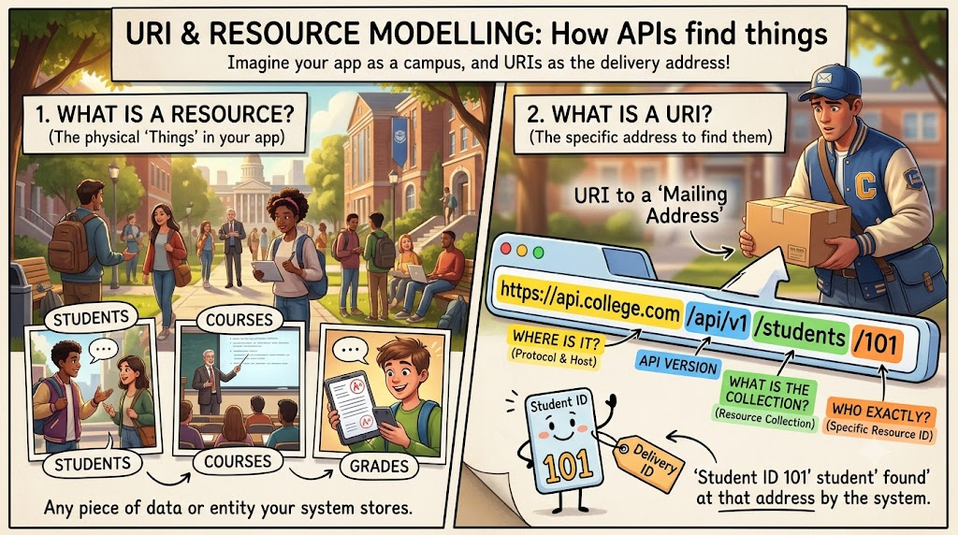

Slide 4
Core Rules for URI & Resource Modelling
Rule 1: Use Nouns (Things), Never Verbs (Actions)
Action | ❌ Bad URI (RPC Style) | ✅ Good URI (REST Standard)
Get all students | GET /api/getAllStudents | GET /api/v1/students
Add a new student | POST /api/createNewStudent | POST /api/v1/students
Update a student | POST /api/updateStudent?id=5 | PUT /api/v1/students/5
Delete a student | GET /api/deleteStudent?id=5 | DELETE /api/v1/students/5

Slide 5
Core Rules for URI & Resource Modelling
Rule 2: Always Use Plural Nouns
❌ GET /api/v1/student
✅ GET /api/v1/students
Rule 3: Collections vs. Single Resources
Collection URI: Represents the entire group (/api/v1/students).
Single Resource URI: Points to one specific item using an identifier (/api/v1/students/101).

Slide 6
Core Rules for URI & Resource Modelling
Rule 4: Sub-Resources for Relationships
When an entity belongs to another entity, model it hierarchically using slash / notation:
✅ GET /api/v1/students/101/courses (All courses taken by student 101)
✅ GET /api/v1/students/101/courses/5 (Course 5 taken by student 101)
Do not nest more than 2 levels deep
❌ GET /colleges/1/departments/2/students/101/courses/5
Rule 5: Use Lowercase and kebab-case
❌ /api/v1/studentProfiles or /api/v1/student_profiles
✅ /api/v1/student-profiles

Slide 7
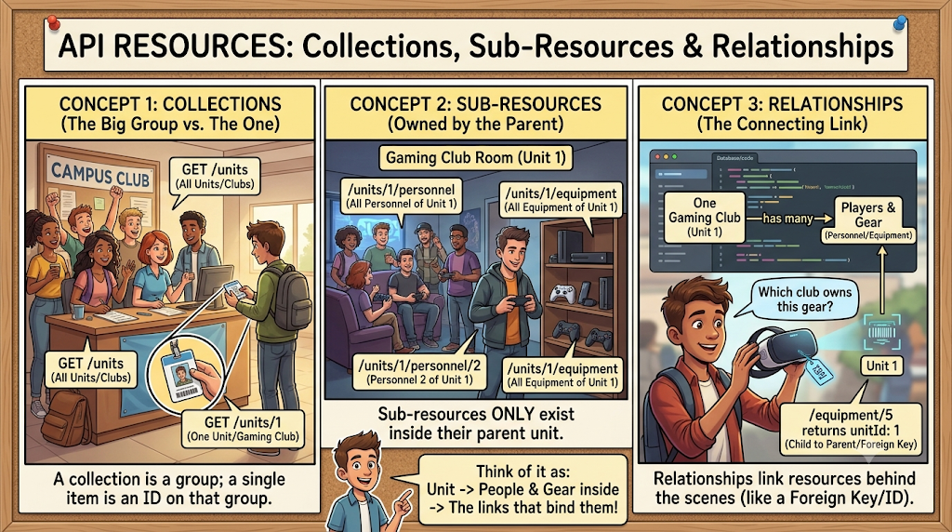

Slide 8
HTTP Methods
HTTP methods tell the API what action wants to perform.
Method | What It Does | Request Body? | Response Code
GET | Read data | No | 200 OK or 404 Not Found
POST | Create a brand-new resource. | Yes | 201 Created
PUT | Replace the entire existing resource. | Yes | 200 OK or 204 No Content
PATCH | Partially update specific fields of a resource. | Yes | 200 OK or 204 No Content
DELETE | Remove a resource. | No | 204 No Content or 404 Not Found

Slide 9
HTTP Status Codes
HTTP status codes tell the client what happened after the API processed the request.
They are 3-digit standardized numbers the server sends back so the client knows what happened.
Code | Meaning | Campus Bites moment
200 OK | Worked, here's your data | Menu fetched successfully
201 Created | New thing made successfully | An order was placed
204 No Content | Worked, nothing to send back | An order was cancelled
400 Bad Request | You sent something wrong | Ordering zero quantity of an item
404 Not Found | That thing doesn't exist | Menu item 99, which was never on the napkin
409 Conflict | Clashes with the current state | Trying to cancel an order that's already “Delivered”
500 Server Error | Something broke on our side | A bug in our code, not the caller's fault

Slide 10
Safety and Idempotency
An HTTP method is Safe if calling it does not change any data on the server or in the database (Read-Only).
An HTTP method is Idempotent if executing it multiple times with the same input produces the exact same end state on the server as calling it once.
Method | Safe? | Idempotent? | Why?
GET | Yes | Yes | Only reads data; database state never changes.
POST | No | No | Calling it 3 times creates 3 duplicate records in the database.
PUT | No | Yes | Overwrites the resource with the exact payload provided; repeating it keeps the exact same state.
PATCH | No | No (by spec)* | Modifies data; operations like { "op": "increment", "amount": 10 } change state every time.
DELETE | No | Yes | Deleting item #10 removes it. Deleting it again leaves it deleted (end state is the same).

Slide 11
Quick Quiz
Which address correctly follows resource-naming rules for “get vada pav, item 2”?
/getMenuItem?id=2
/menu-items/2
/MenuItem/2
/menu-item/getById/2
Answer: B

Slide 12
Quick Quiz
A new student was successfully added. Which status is most suitable?
200 only, in every case
503 Service Unavailable
404 Not Found
201 Created
Answer: D

Slide 13
Quick Quiz
What does /orders/5/items represent?
The items belonging to order 5
Order number 5, repeated 5 times
Item number 5 in every order
A typo for /order-items/5
Answer: A

Slide 14
Quick Quiz
What goes wrong if an API always returns 200, even on failure?
Nothing, it's a style choice
The response gets bigger
Caching, monitoring, and automatic retries all quietly break
JSON stops working
Answer: C

Slide 15
HTTP Headers
Headers are simple Key-Value information passed along with requests and responses.
Header | Purpose | Example
Content-Type | Tells the format of request body | application/json
Accept | Tells the format client wants in response | application/json
Location | Tells URI of a newly created resource | /api/Day1/units/1/personnel/4
X-Correlation-Id | Tracks one request across logs/services | training-request-001
Authorization | Sends token for secured APIs | Bearer <token>

Slide 16


Slide 17
Content Negotiation and Caching
Content Negotiation | Caching
Content negotiation means the client and the API agree on the format of data being sent or received. How it works: Accept (Request Header): The client asks the server, "Please give me data in this format." (e.g., Accept: application/json or Accept: application/xml). Content-Type (Request/Response Header): The sender declares, "Here is data, and it is formatted like this." (e.g., Content-Type: application/json). If the client asks for a format the server doesn't support, the server responds with 406 Not Acceptable. | Caching saves network bandwidth and CPU cycles by storing a copy of the response so the client doesn't need to ask the server for the exact same data again. Key Concepts: Cache-Control Header: Tells the client or browser how long it can keep the data before asking again (e.g., Cache-Control: max-age=60 means "valid for 60 seconds"). ETag (Entity Tag): A unique fingerprint (like a hash or version number) of the resource. When data changes, the ETag changes. The client sends the ETag back in the If-None-Match header on subsequent calls. If the data hasn't changed, the server returns 304 Not Modified with an empty body, saving bandwidth.

Slide 18


Slide 19


Slide 20
Standard Error Responses
When an API request fails, the API should return a clear and consistent error response.
Instead of returning confusing text like:
Something went wrong
Return structured JSON that tells the client:
  What happened
  Status code
  Why it happened
  Which request caused the error
A standard error response helps developers, testers, and support teams understand the problem quickly.

Slide 21
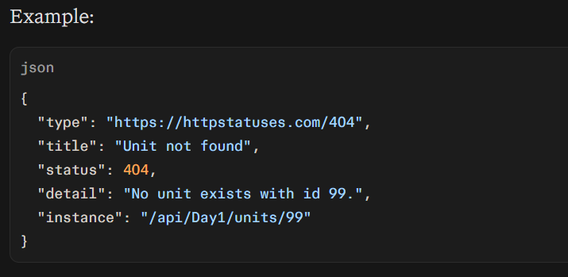
Problem Details
In ASP.NET Core, a common standard error format is called Problem Details.
Field | Meaning
type | Optional link/code describing the error type
title | Short error message
status | HTTP status code
detail | More detailed explanation
instance | The API path where the error happened

Slide 22


Slide 23
Quick Quiz
Which header usually describes the format of the request body?
Accept
Location
Content-Type
Retry-After
Answer: C

Slide 24
Quick Quiz
What's the main benefit of a standard error shape like Problem Details?
It makes errors shorter
The calling app writes one error-handling routine that works for every endpoint
It removes the need for status codes
It's required by JSON
Answer: B

Slide 25
Quick Quiz
What problem does a correlation ID solve that caching and filteration don’t?
Speed
Formatting JSON consistently
Reducing payload size
Tracing one request's path across multiple systems
Answer: D

Slide 26
Q&A
The End

